Slide 1


NEXT GEN EMPLOYABILITY PROGRAM
CREATING A FUTURE-READY WORKFORCE
Student Name :
Lingesh R
Student ID :
College Name :
STU6765aa189342a1734715928
Vemana Institute of Technology

Slide 2
CAPSTONE PROJECT SHOWCASE
Project Title
Digital Game Store
Abstract | Problem Statement | Project Overview | Proposed Solution | Technology Used | Modelling & Results | Conclusion | Q&A

Slide 3
Abstract
1
A full-stack digital game store where users can browse, buy, and explore games, while admins manage products, media, and system requirements with ease.
2
A modern MERN-based platform for digital game discovery and management that supports secure login, product CRUD, trailers, and rich metadata.
3
A responsive web app to showcase, edit, and sell digital games, including admin controls, media uploads, and detailed game specs.
4
A digital storefront for games with seamless user and admin experience featuring product editing, secure auth, and multimedia support.

Slide 4


Problem Statement
Design and develop a tailored e-commerce platform leveraging the MERN stack (MongoDB, ExpressJS, React, Node.js). The React frontend offers a seamless user experience for browsing products, managing a cart, and completing purchases, while ExpressJS handles secure authentication, inventory control, and order processing with data stored in MongoDB.
Objectives
Develop a responsive and user-friendly interface using React for seamless shopping experiences.
Implement secure user authentication and authorization with JWT and ExpressJS.
Manage product listings, inventory, and orders efficiently using Node.js and MongoDB.
Provide admin functionalities for managing products, users, and orders.

Slide 5

Project Overview
Designed a custom e-commerce platform using the MERN stack (MongoDB, ExpressJS, React, Node.js).
Built an interactive React frontend for browsing, searching, and purchasing digital games.
Implemented secure user authentication and authorization using JWT and ExpressJS.
Managed product inventory, cart operations, and order processing via Node.js backend.
Stored all dynamic data like users, products, and orders in MongoDB.
Integrated admin dashboard for managing products, users, and orders.

Slide 6
Proposed Solution
Frontend (React): Design a responsive UI with React, allowing users to browse, search, and filter games by categories such as Action, RPG, or Strategy. Display tag-based carousels (e.g., "Top Rated", "New Releases") on the homepage using fetched product data based on category IDs.
Backend (Node.js + Express): Implement RESTful APIs to handle product filtering by category, search queries, and pagination. Use ExpressJS routes to manage user actions like adding to cart, placing orders, and admin operations.
Authentication: Secure the platform with JWT-based authentication, allowing role-based access (user/admin) for protected operations such as managing products or viewing orders.
Database (MongoDB): Store product information with category references (via category IDs) for efficient filtering. Organize users, orders, and game metadata in a scalable and relational document structure.

Slide 7
Technology used
1) Frontend:
React.js – For building dynamic, responsive UI.
React Router – For seamless page navigation.
Axios – For HTTP requests to backend APIs.
CSS / SCSS – For styling components.
2) Backend:
Node.js – Runtime environment for server-side logic.
Express.js – Framework for building RESTful APIs.
JWT (JSON Web Tokens) – For secure authentication.
3) Database:
MongoDB – NoSQL database for storing users, products, and orders.
Mongoose – ODM for MongoDB, schema modelling and validation.
4) Tools:
VS Code – Code editor for development. Git & GitHub – Version control and code collaboration.

Slide 8
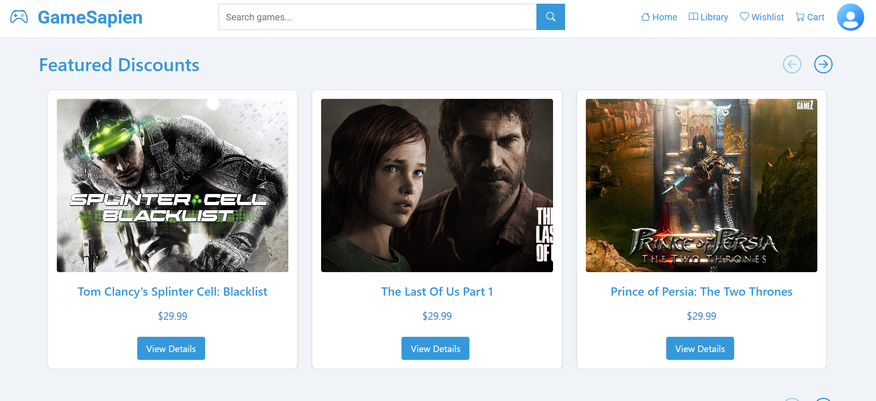
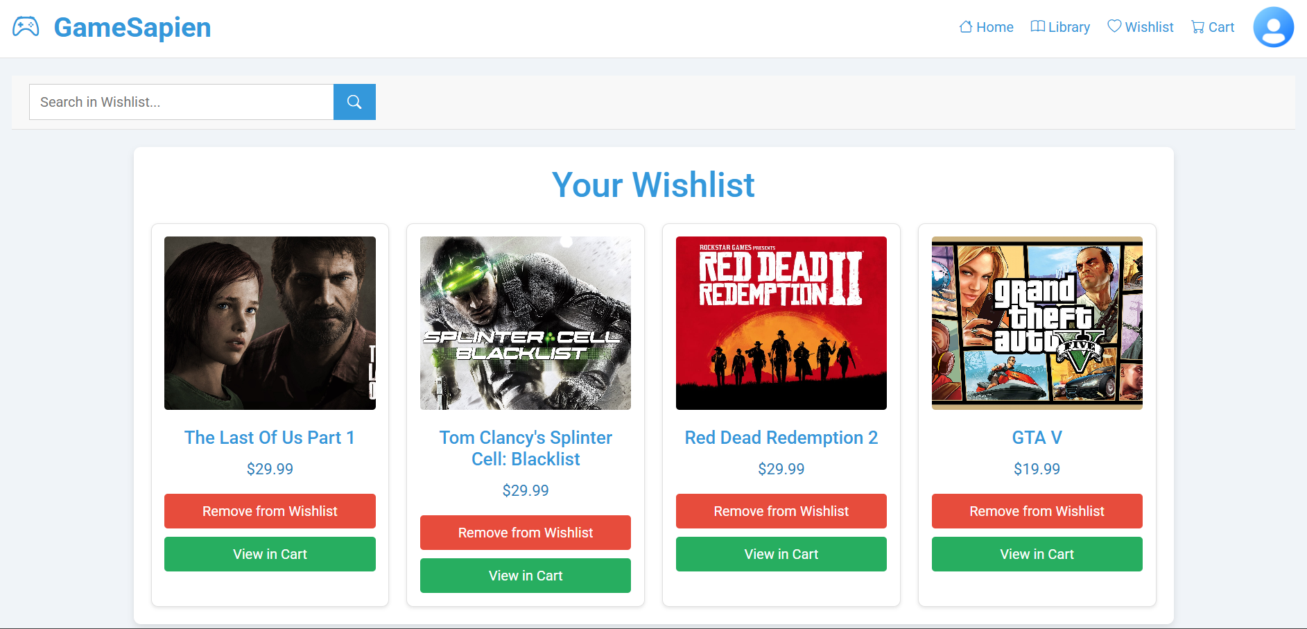
Modelling & Result

Slide 9
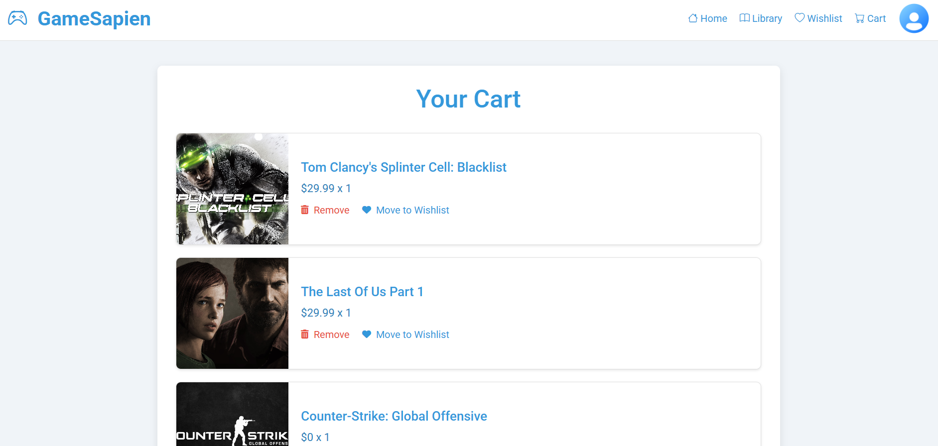
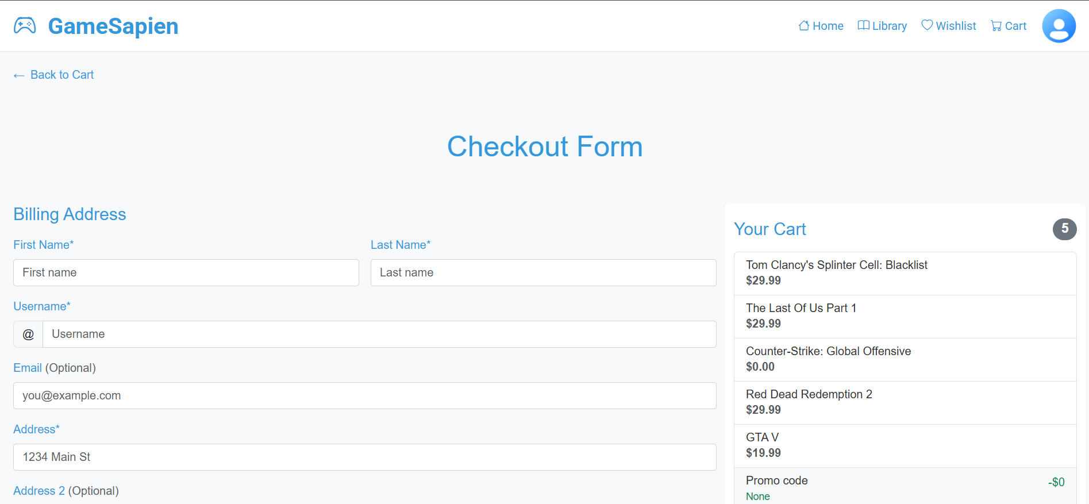
Modelling & Result

Slide 10
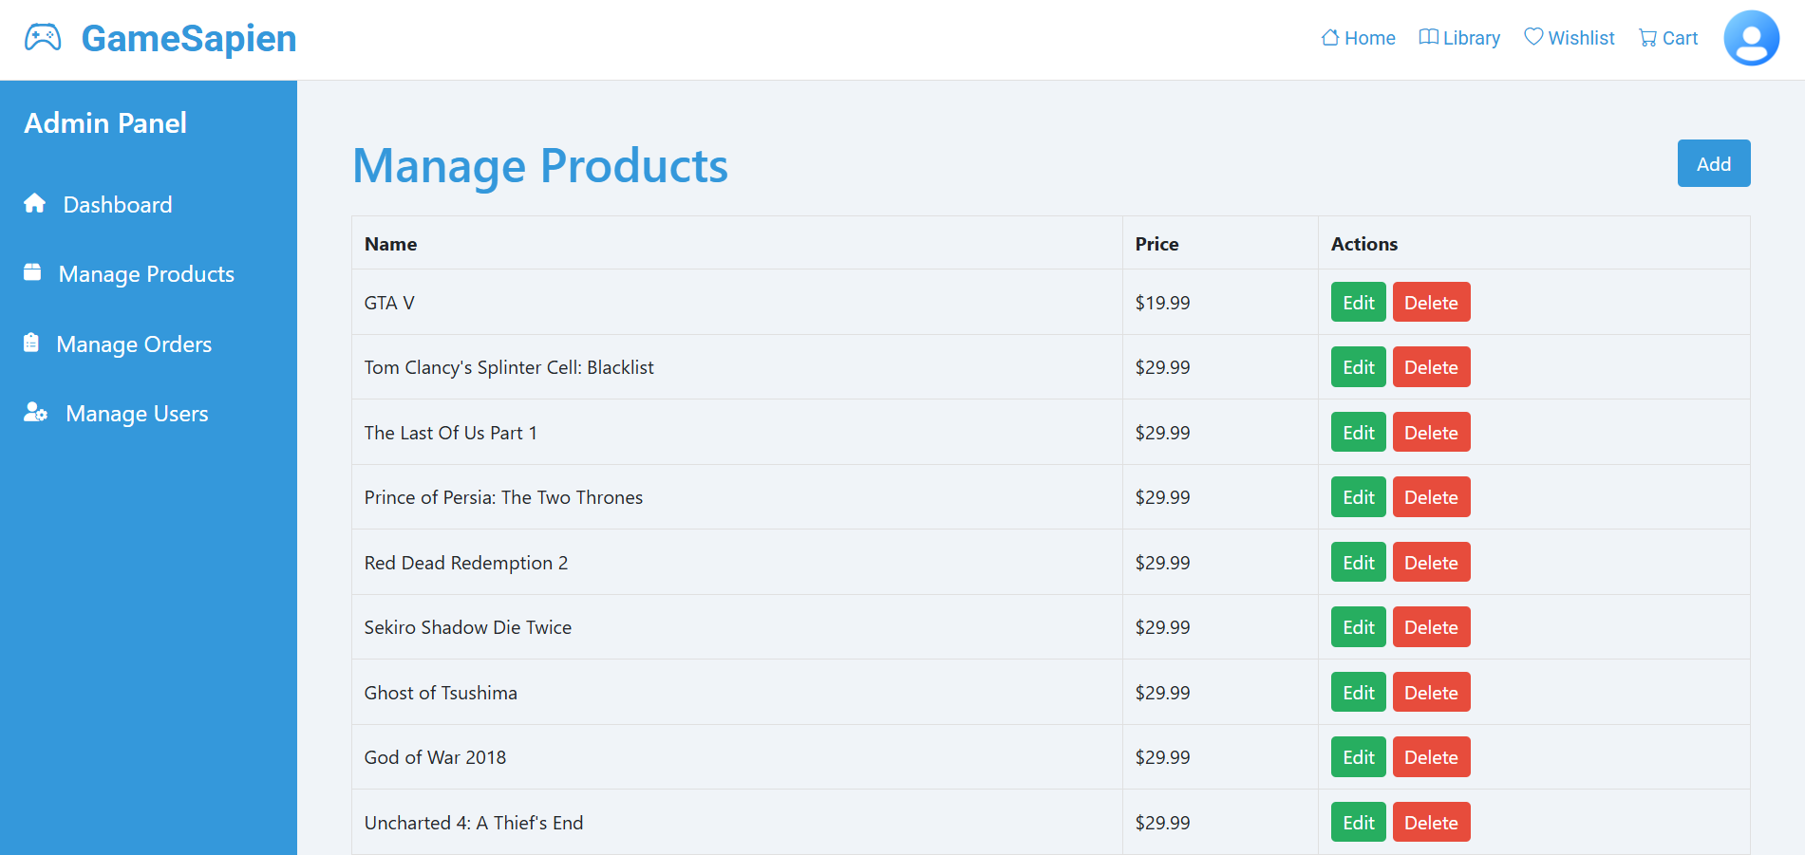
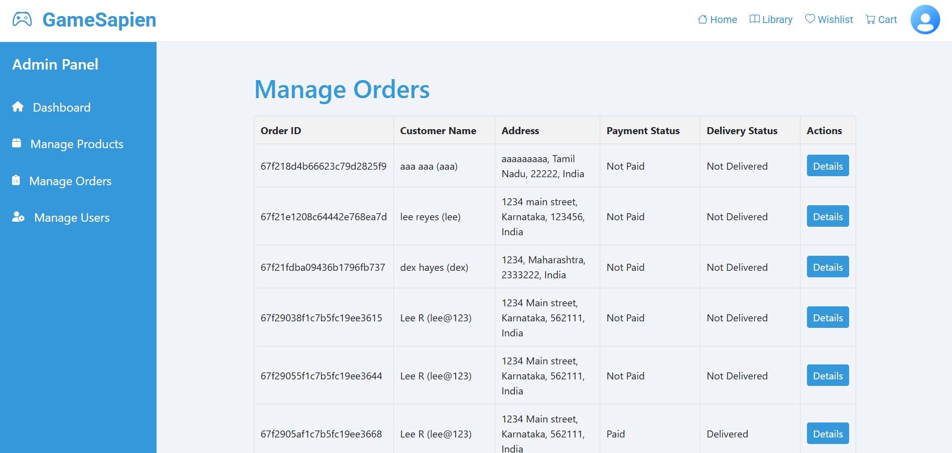
Modelling & Result

Slide 11

Conclusion
Successfully built a full-stack custom e-commerce platform tailored for digital games.
Seamless user experience achieved through a responsive React frontend.
Secure authentication and efficient data handling implemented using JWT, ExpressJS, and MongoDB.
Robust admin controls added for managing products, users, and orders.
Category-based filters and carousels enhanced discoverability and improved game browsing.
Project demonstrates a strong grasp of MERN stack development and modern web app architecture.

Slide 12


Notes:
Thank You !!

